Slide 1
"CAN HE CHANGE? WHAT WOULD IT TAKE FOR HIM TO CHANGE?”
A NEW FRAMEWORK FOR ADVOCATES TO HELP BATTERED WOMEN BETTER UNDERSTAND WHY MEN ARE ABUSIVE AND WHAT IT WOULD TAKE FOR THEM TO CHANGE
Melissa Scaia and Scott Miller
Domestic Abuse Intervention Project
www.theduluthmodel.org

Slide 2
The Duluth Model
The Duluth Model is an organizing method that prioritizes victim safety and offender accountability within a social change framework. The model guides organizers to build interventions within systems that are aligned with the lived experience of victims.
The Duluth Model creates a distinctive form of organized public responses to domestic violence. It is characterized by:
Clearly identifiable and largely shared assumptions and theories about the source of battering and the effective means to deter it.
Empirically tested intervention strategies that build safety and accountability into all elements of the infrastructure of processing cases of violence.
Well defined methods of inter-agency cooperation guided by advocacy programs.
Notes:
So many CCR’s get together and don’t spend the time organizing how they’ll organize. The result is lack of sustainability, commitment, judgment of others, lack of change and frustration. The Duluth Model has been developed through over 30+ years of organizing and has built a method through trial and error that provides a theoretical foundation to organize from and a direction that keeps the focus on solutions to issues of safety and accountability that is victim centered.

Slide 3
Core Principles of Social Change of the Duluth Model Approach
Create and experience that is liberating rather than dominating
Engage in dialogue vs. counsel and advise
Approach as a social problem vs. a problem with an individual
Include those subject to the oppression in the organizing to change the conditions under which they live

Slide 4
The Duluth Model Approach
Coordinated Community Response (CCR)
911
Individual Advocacy & Shelter
Prosecution
Probation
Men's Non-Violence Program
Courts
Restorative Justice Sentencing & Restorative Circles
Law Enforcement
Jail

Slide 5
What is the need that this videoconference is trying to address?
Battered women want to understand why the men who say they love them are also violent, hurtful and abusive to them.
Battered women often ask,
Why does he hurt me?
Why does he do this to me?
Do you think he could change?”
Or they say,
“He promised he wouldn’t hurt me anymore. I don’t think he’ll do it again.”

Slide 6
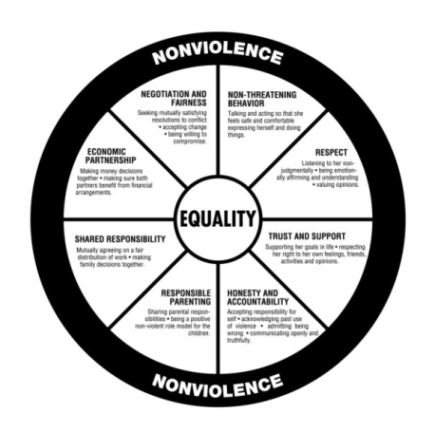
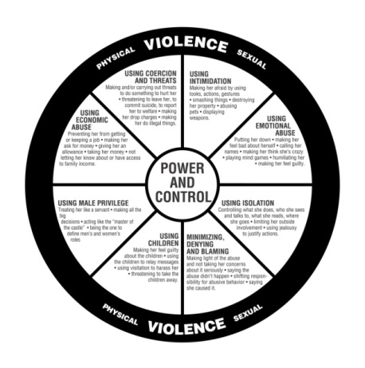
Themes of the Duluth Model Men’s Non-Violence Curriculum
Nonviolence
Responsible Parenting
Physical Violence
Using Children
Nonthreatening Behavior
Shared Responsibility
Using Intimidation
Using Male Privilege
Respect
Economic Partnership
Using Emotional Abuse
Using Economic Abuse
Trust and Support
Sexual Respect
Using Isolation
Sexual Abuse
Honesty and Accountability
Negotiation and Fairness
Minimizing, Denying and Blaming
Using Coercion and Threats

Slide 8
Tools of the Duluth Model Men’s Non-Violence Curriculum
The Equality Wheel
The Power and Control Wheel
The Control Log
The Equality Log
Group Dialogue: The Medium of Learning
Male/Female Co-Facilitation
Video Vignettes
Women’s Perspective Video
Group Exercises/Dialogue
Role-Plays
Assignments
Lesson Plans for the Three Parts of each Theme
Facilitating a Men’s Nonviolence Class Videos

Slide 9
Control Log from the Duluth Model Creating a Process of Change for Men Who Batter curricula
an essential teaching and analysis tool of the Creating a Process of Change for Men Who Batter curriculum
is designed to facilitate an analysis of six key elements of abusive behaviors and then to identify how men can be non-violent and non-controlling in intimate partner relationships with women.

Slide 10
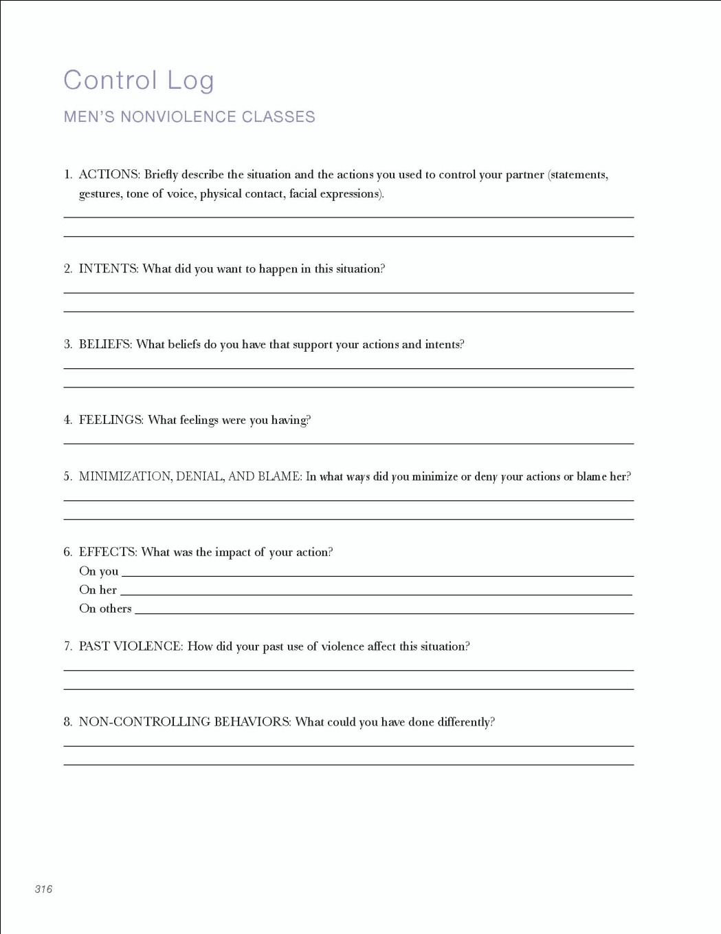
Control Log
Actions
Intents
Beliefs
Feelings
Minimization, Denial,
and Blame
Effects
On you
On her
On others
Past Violence
Noncontrolling Behaviors

Slide 11
Adapting the Control Log for use with Battered Women by Advocates
The Domestic Abuse Intervention Program (DAIP) staff in Duluth, MN has taken the control log for working with men who batter and adapted it for use by advocates to utilize when helping battered women understand and answer the questions, “Why is he violent? Will he change?”
This new tool can be used when meeting with battered women one-on-one or in a group setting
See accompanying handouts

Slide 12
Upcoming Webinars / Videoconferences hosted by “the Duluth Model”
Why Traditional Parenting Classes Don’t Work with Men Who Batter
Adapting the “Equality Log” from the Duluth Men’s Non-Violence Program for use with Battered Women by Advocates
The Duluth Model’s Coordinated Community Response: An Introduction
Collusion – What Does It Look Like in a Men’s Non-Violence Program?
Only $20 per site

Slide 13
Resources
Domestic Abuse Intervention Programs
www.theduluthmodel.org
Domestic Violence Turning Points/Advocates for Family Peace
www.dvturningpoints.com www.stopdomesticabuse.org
Battered Women’s Justice Project
www.bwjp.org
Casa de Esperanza
www.casadeesperanza.org
Mending the Sacred Hoop Technical Assistance Project
www.msh-ta.org
Praxis International
www.praxisinternational.org

